Slide 1


01
book recommendation system.
NATHASYA GUNAWAN | FINAL PROJECT
NATHASYA GUNAWAN | JCDS-09 JKT

Slide 2

02
HI,
I'M NATHASYA
GUNAWAN!
BACHELOR OF ARTS IN MEDIA, COMMUNICATION, AND CULTURAL STUDIES - NEWCASTLE UNIVERSITY
SEO CONTENT WRITER
COPYWRITER
DIGITAL STRATEGIST

Slide 3
03
Timeline
BUSINESS PROBLEM
DATASET
EDA
MACHINE LEARNING
EVALUATION
NATHASYA GUNAWAN | FINAL PROJECT

Slide 4
04
Business Problem
Recommendation System in Book Retail
Big data is now being utilized at a level that we could have never previously imagined, but the important part still remains on how we apply the data in a business context, and how we make the most out of it.
For online book retailers, product ratings can play a huge role for making sound business decisions. As the data on product ratings continue to grow over time, companies can take advantage of this information and enhance customer experiences.
NATHASYA GUNAWAN | FINAL PROJECT

Slide 5
05
Business Problem
Recommendation System in Book Retail
Can book recommendation system help book retail in giving out the best recommendation for their customer to enhance customer experience?
NATHASYA GUNAWAN | FINAL PROJECT

Slide 6
06
DATASET
GOODBOOKS-10K
https://www.kaggle.com/zygmunt/goodbooks-10k
The dataset contains about 1 million ratings across 10000 different books. In most cases, there are at least 10 books rated by each user and the rating lies between 0 and 5.
DATASET
books.csv - metadata for each book (goodreads IDs, authors, title, average rating, etc.) - (1000 x 23)
book_tags.csv - contains tags/shelves/genres assigned by users to books. Tags in this file are represented by their IDs. - (999912 x 3)
tags.csv - translates tag IDs to names. - (34252 x 2)
rating.csv - contains ratings - (5976479 x 3)
NATHASYA GUNAWAN | FINAL PROJECT

Slide 7
07
DATA FEATURES
TITLE
AUTHORS
AVERAGE_RATING
The
name under which the book was published.
Names
of the authors of the book. Multiple authors are delimited with a comma (,).
The
average rating of the book received in total.
NATHASYA GUNAWAN | FINAL PROJECT

Slide 8
08
DATA FEATURES
RATINGS_COUNT
USER_ID
BOOK_ID
Total
number of ratings the book received.
A
unique Identification number for each user.
A
unique Identification number for each book.
NATHASYA GUNAWAN | FINAL PROJECT

Slide 9
09
DATA FEATURES
RATINGS
TAG_NAME
BOOKS_COUNT
Ratings given to a book by a user.
Book genres assigned to each book
Number
of editions a book have.
NATHASYA GUNAWAN | FINAL PROJECT

Slide 10
10
EXPLORATORY DATA
ANALYSIS

Slide 11
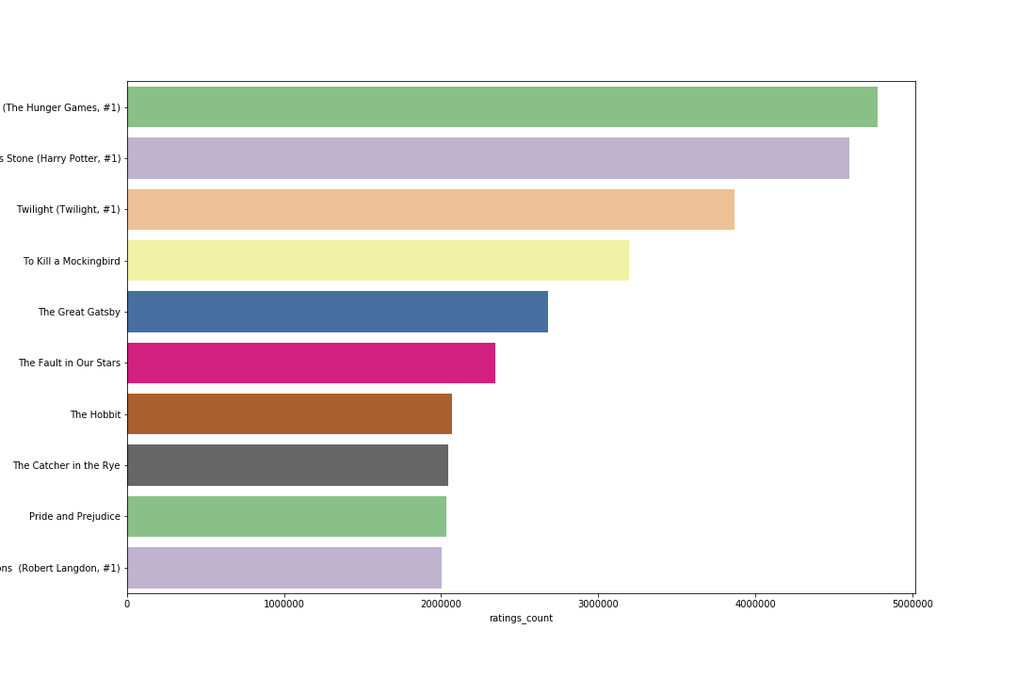
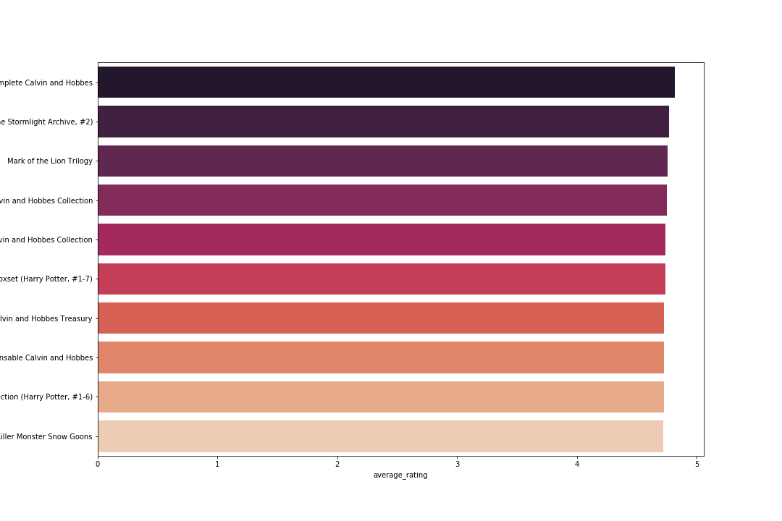
Most Rated Books
Top Rated Books
Books with the highest amount of ratings given on Goodreads
Books with the highest ratings on Goodreads

Slide 12
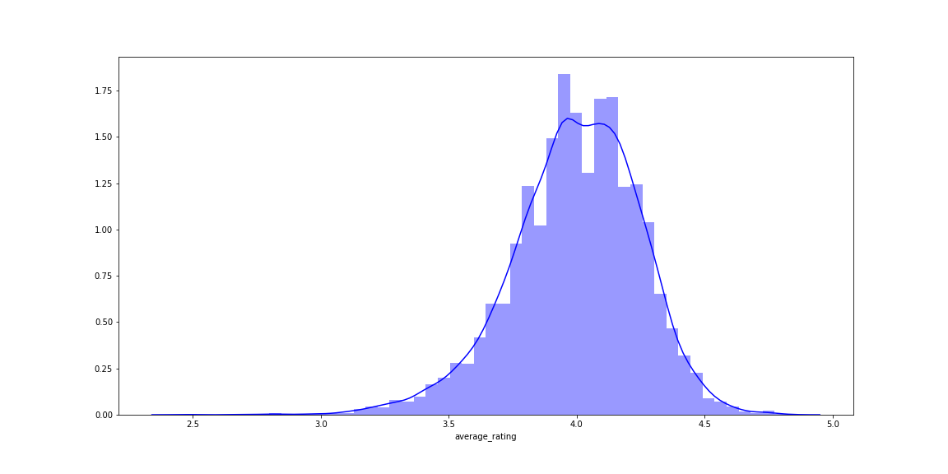
Book Rating Distribution
Most people tend to give quite positive ratings to books. Most of the ratings are in the 3-5 range, while very few ratings are in the 1-2 range.

Slide 13
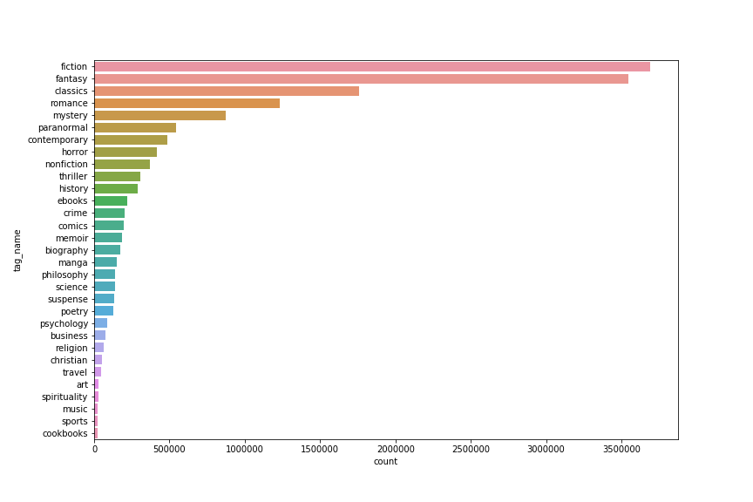
Book Genres
In this data there is a high number of Fiction books, followed by Fantasy and Classics. Interestingly there is a low number of music, sports, and cookbooks in this data.

Slide 14
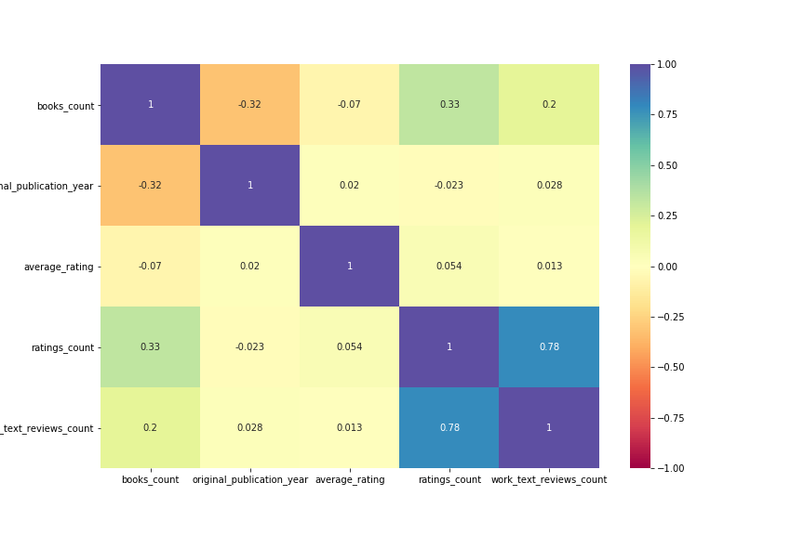
Correlation Heatmap

Slide 15
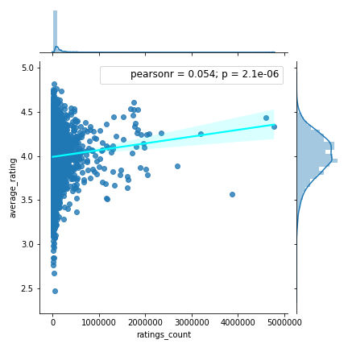
NATHASYA GUNAWAN | FINAL PROJECT
RELATIONSHIP BETWEEN
THE NUMBER OF RATINGS &
THE AVERAGE RATINGS
Theoretically, it might be that the popularity of a book (in terms of the number of ratings it receives) is associated with the average rating it receives, such that once a book is becoming popular it gets better ratings. However, our data shows that this is true only to a very small extent. The correlation between these variables is only 0.054.

Slide 16
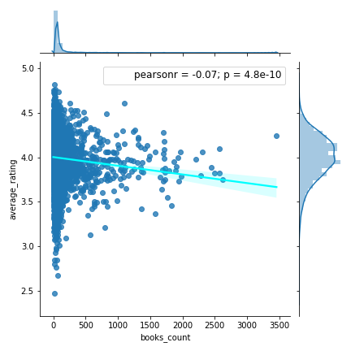
NATHASYA GUNAWAN | FINAL PROJECT
RELATIONSHIP BETWEEN
THE NUMBER OF EDITIONS &
THE AVERAGE RATINGS
The dataset contains information about how many editions of a book are available in books_count. These can either be different editions in the same language or also translations of the book into different languages. So one might assume, that the better the book is the more editions should be available. In fact, data show exactly the opposite pattern: The more editions a book has the lower is the average rating. The causal direction of this association is of course unclear here.

Slide 17
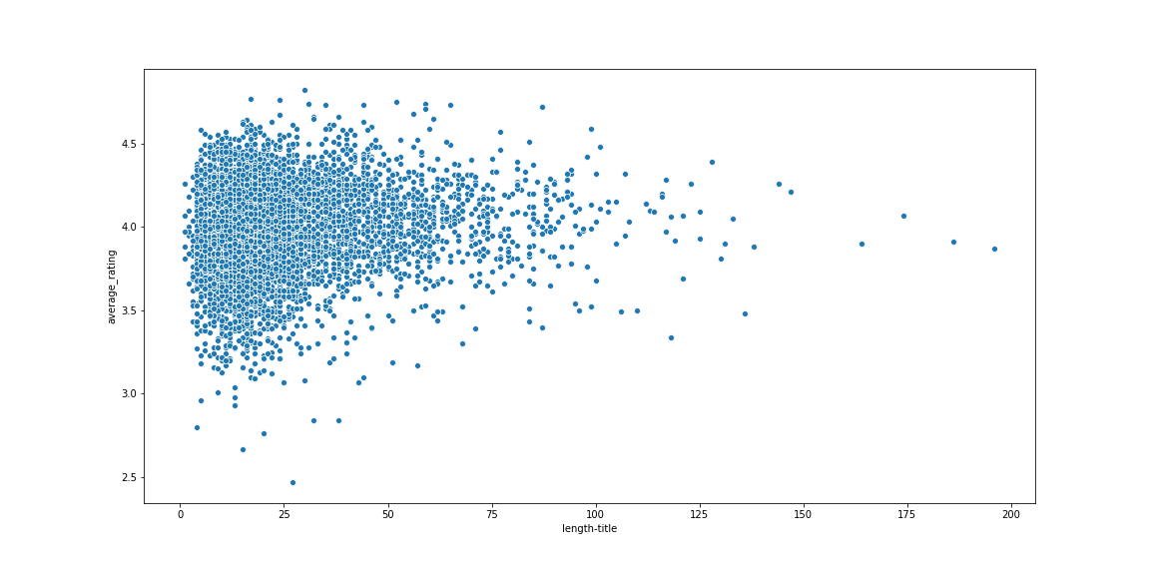
NATHASYA GUNAWAN | FINAL PROJECT
DOES TITLE LENGTH AFFECTS RATING?
So, the highly rated books have rather short titles. The graph shows that a straight line can be plotted but very approximately to say that as the length of title increases, the rating remains constant (at around 4).

Slide 18
18
MACHINE LEARNING

Slide 19
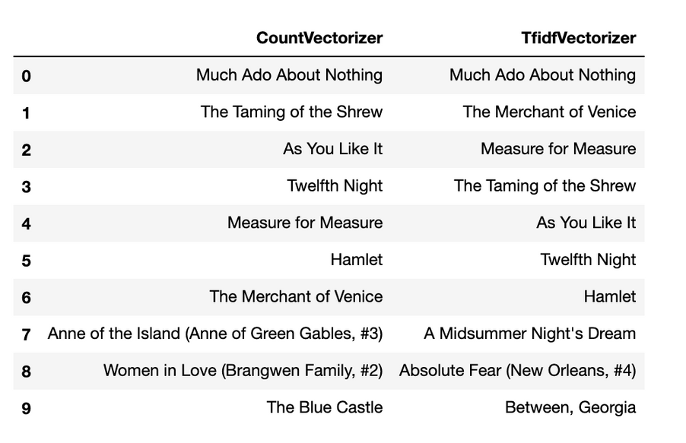
19
Get recommendation for title:
Romeo and Juliet
CONTENT-BASED FILTERING
This approach utilizes the characteristics of an item to find items with similar properties. Those characteristics are the keywords of an item. For this particular machine learning, I utilize the feature Title, Authors, and Tag_Name (Genre) to give out recommendations.
TFIDFVECTORIZER & COUNTVECTORIZER
NATHASYA GUNAWAN | FINAL PROJECT

Slide 20
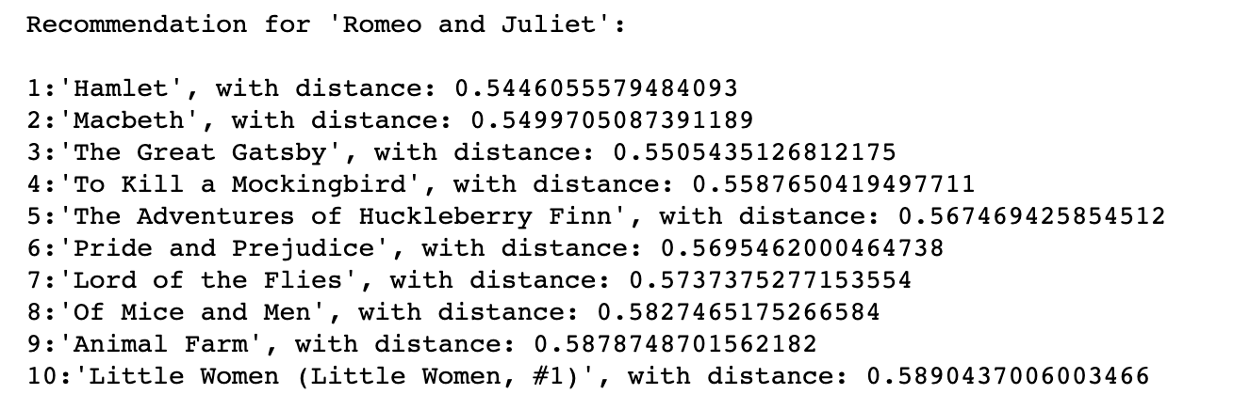
Get recommendation for title:
Romeo and Juliet
NATHASYA GUNAWAN | FINAL PROJECT
COLLABORATIVE FILTERING
The collaborative filter recommender systems are based on interactions between users
and items. Instead of focusing on the characteristics of an item, the system compares similar actions made by other users.
20
NEAREST NEIGHBORS
For this machine, I use Nearest Neighbors by utilizing ratings to find the nearest title to the title being input by the user.

Slide 21
21
Both model seems to give out reasonable recommendations that will help customers who are looking for their next read. However each models come with their own weaknesses.
Content-Based Filtering
To get a better recommendation using content-based filtering, there needs to be data on either book descriptions or written text review. By utilizing these two data, we may be able to get a better recommendations.
Collaborative Filtering
As collaborative filtering rely on ratings given by the users, the data may be bias as popular books may receive more ratings.
EVALUATION
NATHASYA GUNAWAN | FINAL PROJECT

Slide 22
22
THANK YOU!

